Slide 1
Complexity: changes

Slide 2
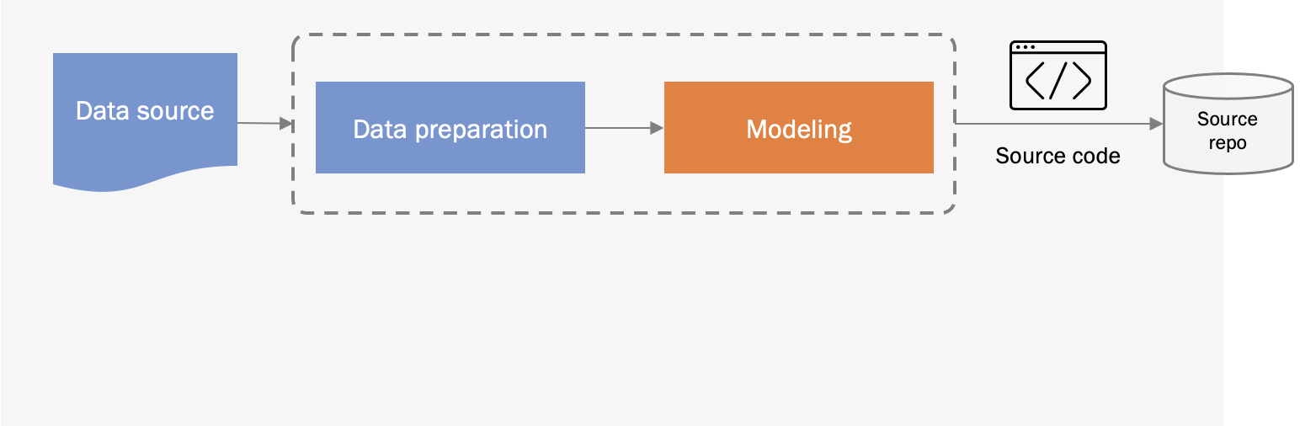
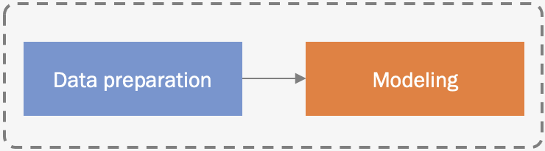
Lab
CI/CD
Pipeline building and testing
Packages
CD Pipeline Deployment
Feature store
Production
Model serving
Continuous Deployment (CD)
Model repo
Data validation
Data preparation
Model serving
Scaling
Logging
Monitoring
Trigger
Model monitoring
Model API
Live data

Slide 3
Experiments

Slide 4
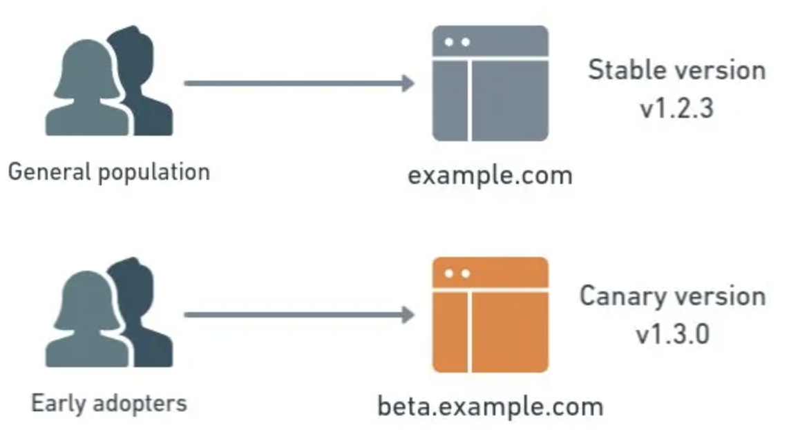
Canary deployments

Slide 5
Data and Model Drift

Slide 6
Predictive service

Slide 7
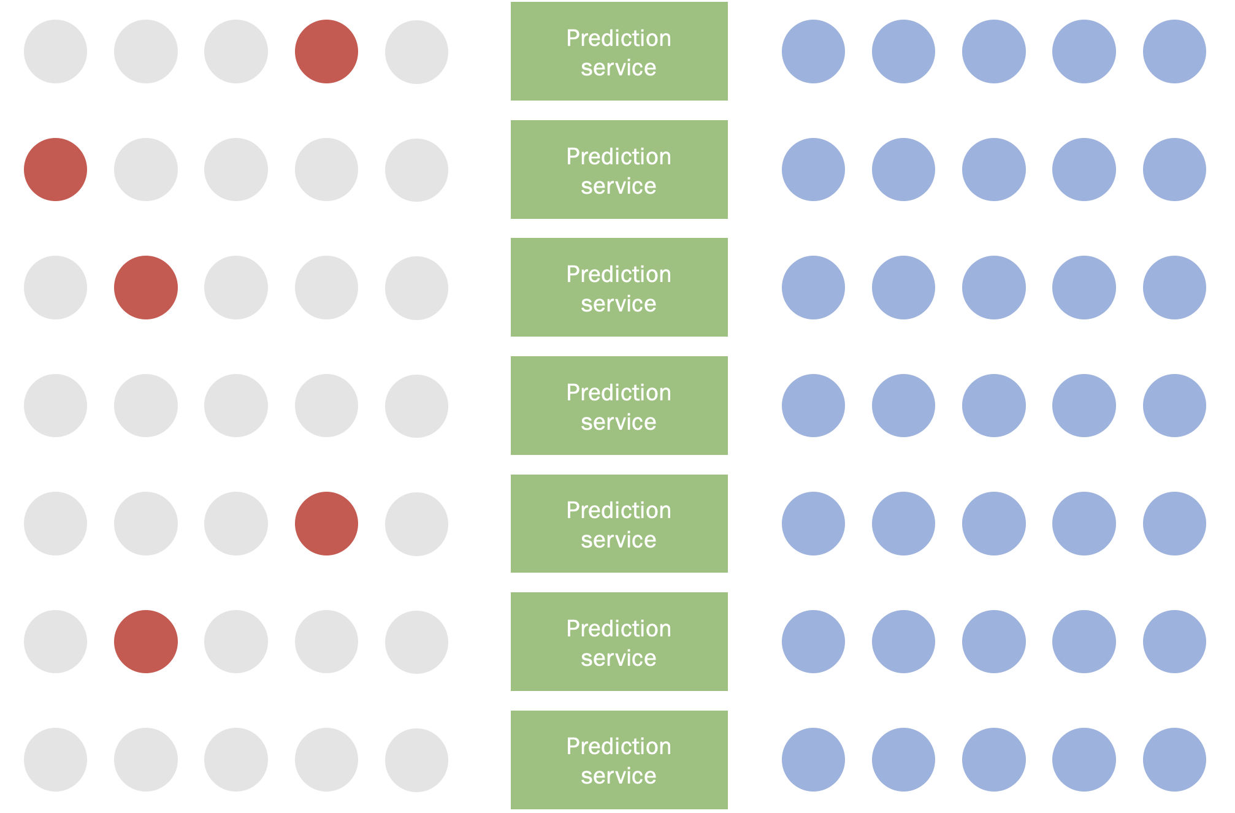
With hundreds of models in production,...
We need to automate data validation processes
and models updates

Slide 8
1
The distribution of data (inputs and labels)
2
Change in schema
What may go wrong?
3
Relationship between features and labels
4
A data source (eg maintained by others)
5
An upstream model

Slide 9
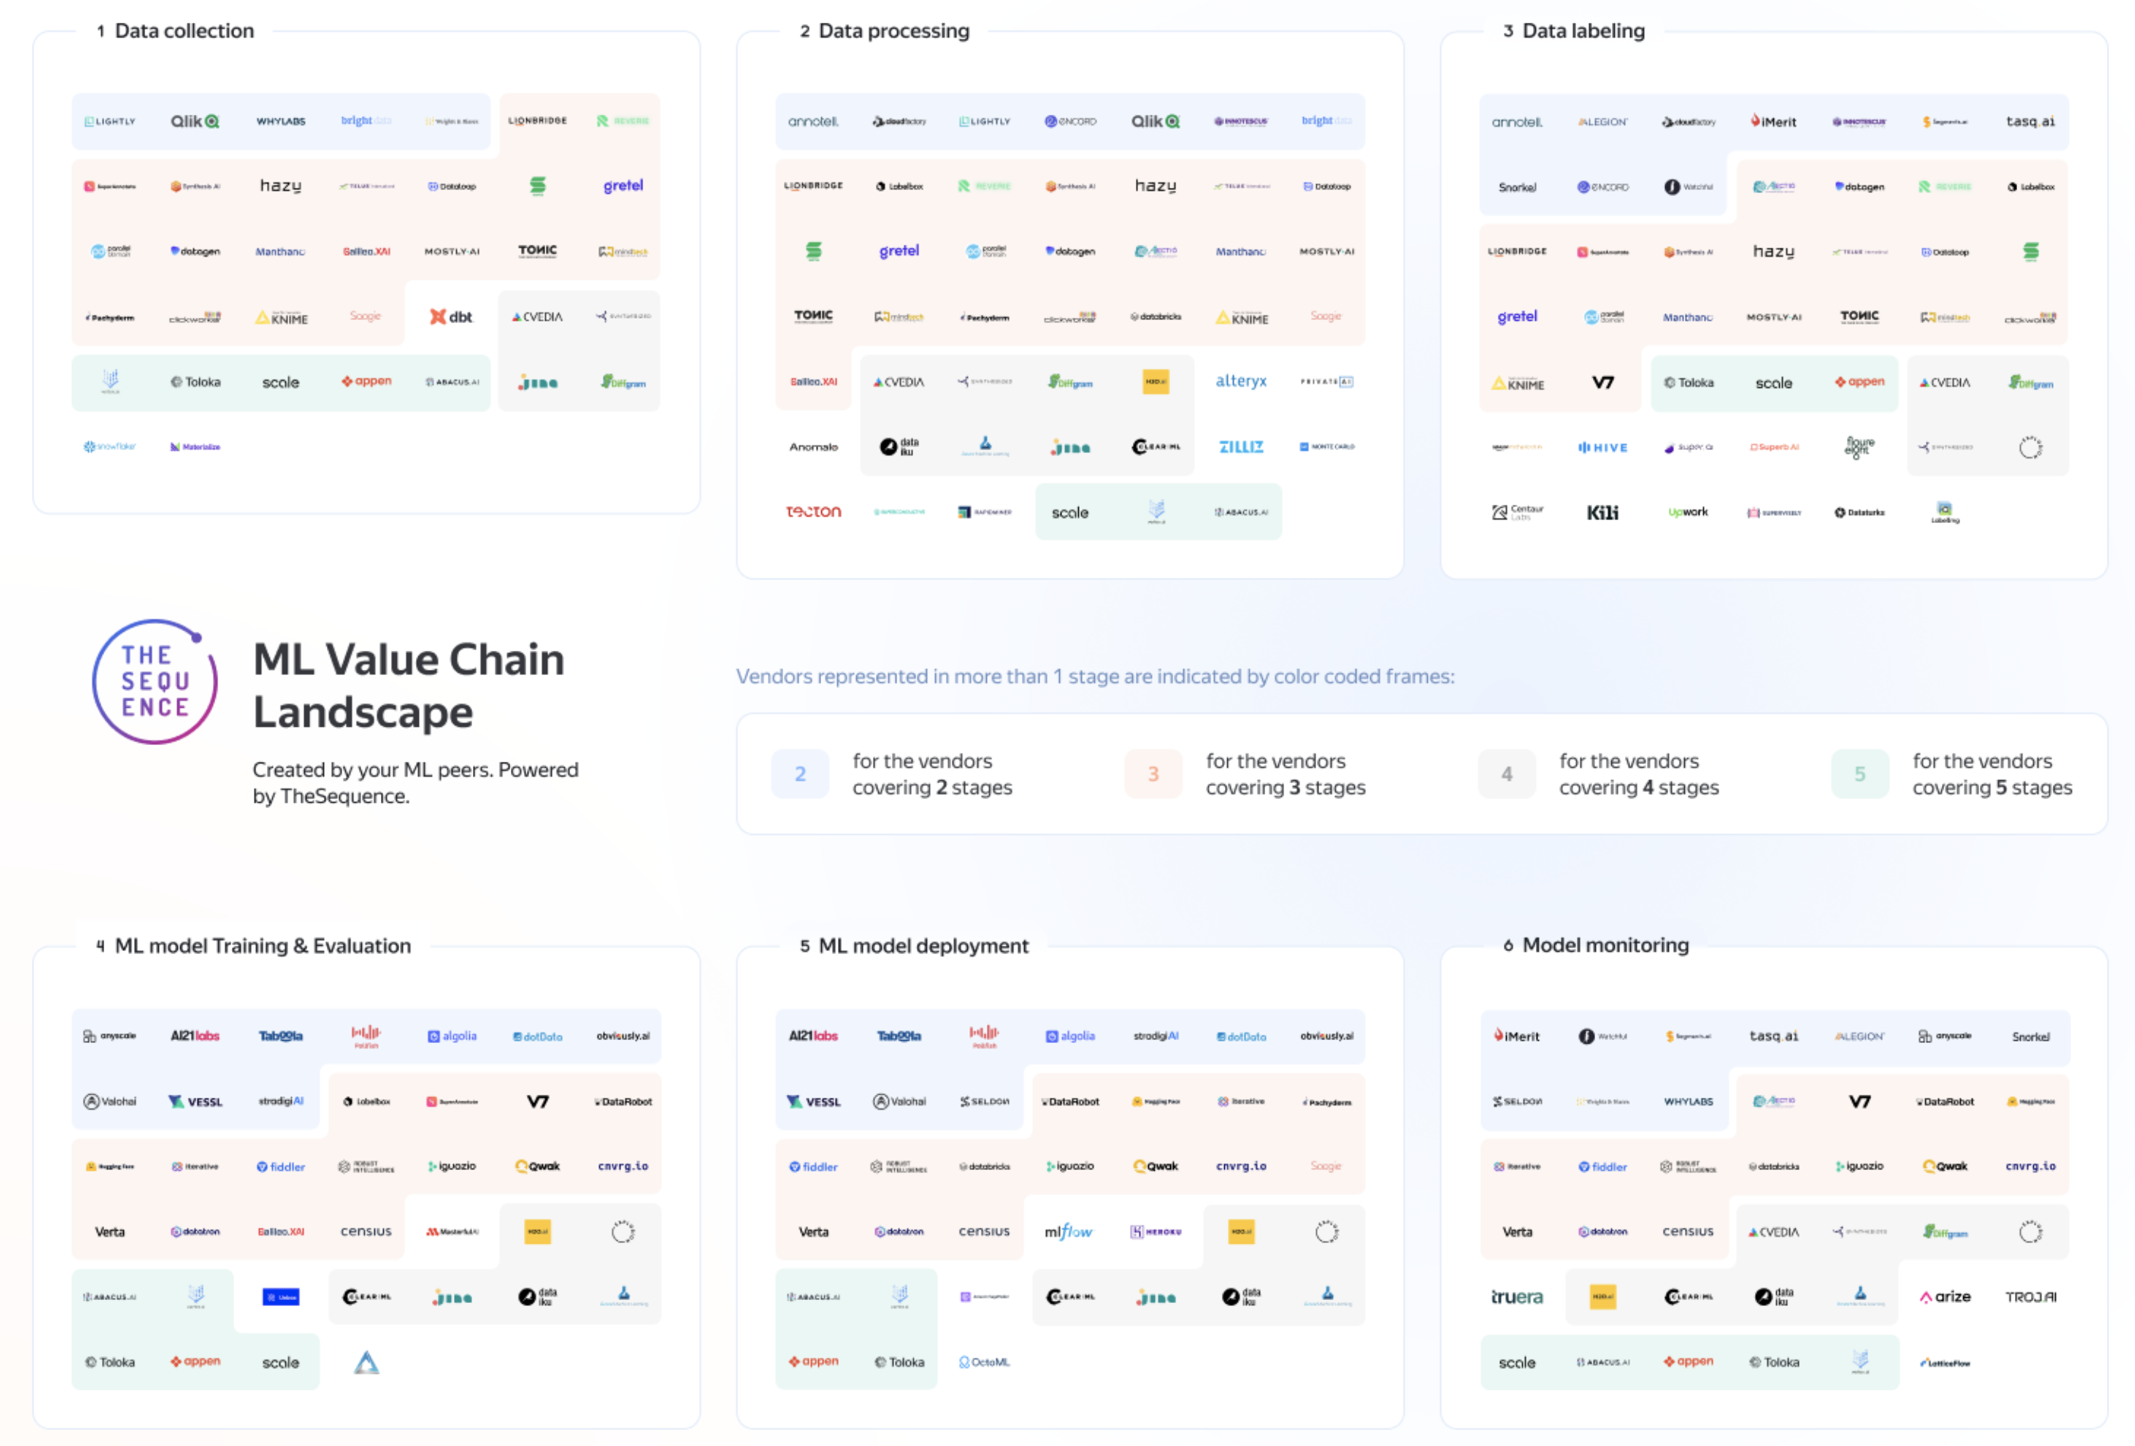
Solutions

Slide 10
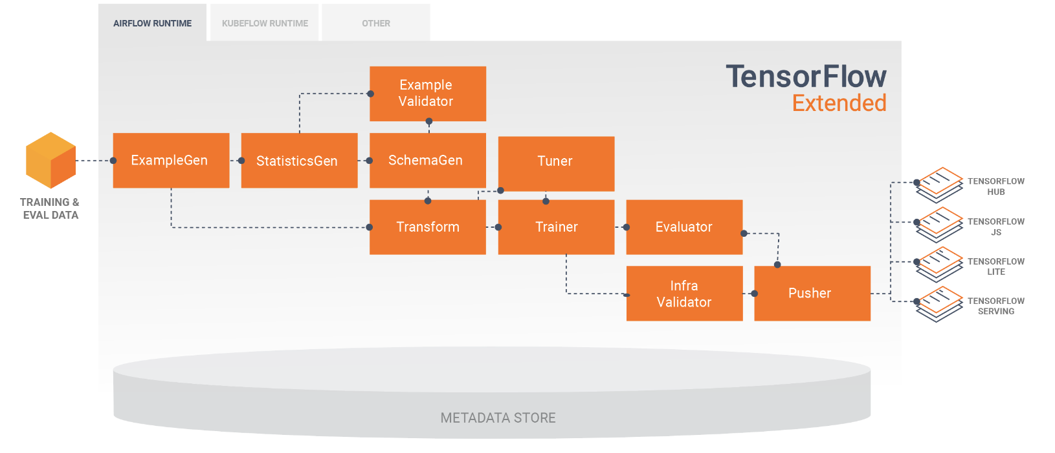
Solutions

